Slide 1
MentorLink
By FARHAN SAEED

Slide 2

“When the student is ready the teacher will appear. When the student is truly ready... The teacher will Disappear.”
Tao Te Ching

Slide 3
TABLE OF CONTENT
Introduction to MentorLink
MoodBoard
UI Design
Persona
Elements of Design
Technologies
Progress

Slide 4
Introduction to MentorLink
MentorLink is a mobile application that is programmed to foster meaningful connections between students or apprentices in any educational domain or setting with mentors who are eager to share their knowledge, experience, and worldview with the students. In an everchanging world, a connection between generations is revolutionary. App will have user friendly interface that will allow easy access to mentors from various walks of like offering their very personalized and student focused insights. MentorLink will utilize location-based pairing where students can find mentors in their locality to have a face-to-face meeting for a price set by their mentors.

Slide 5
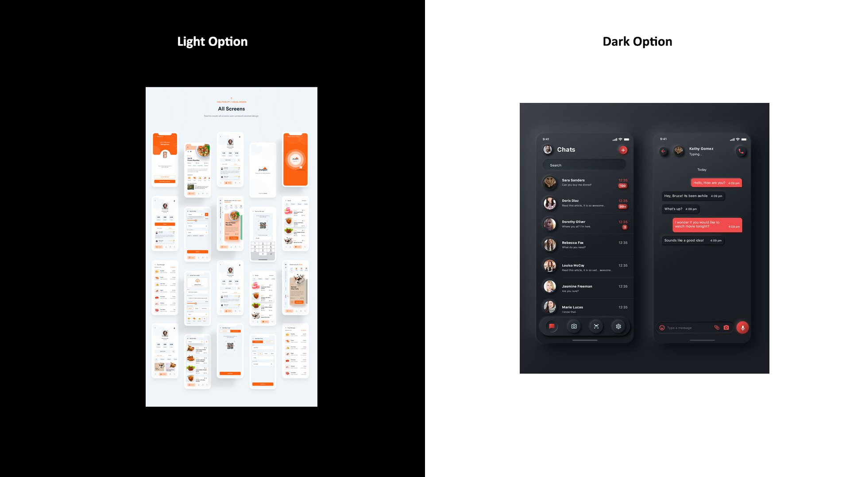
MoodBoard

Slide 6
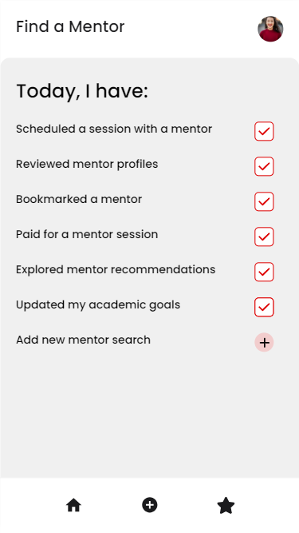
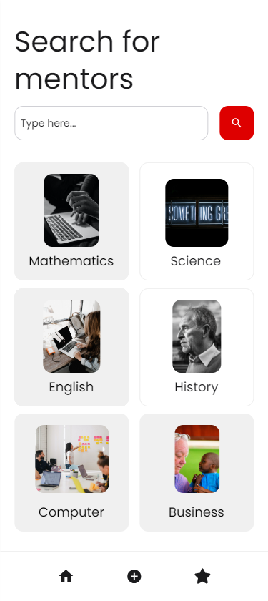
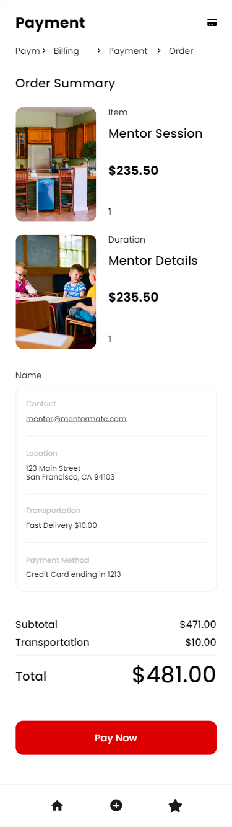
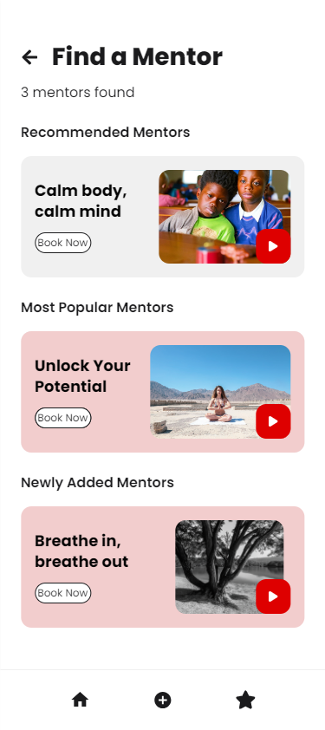
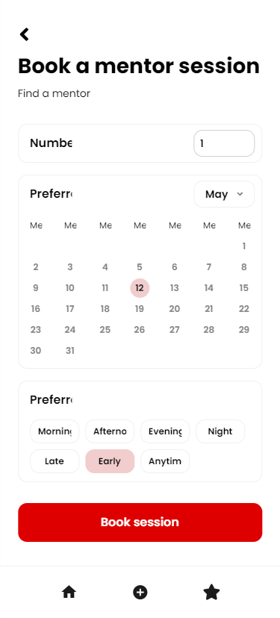
UI Design

Slide 7
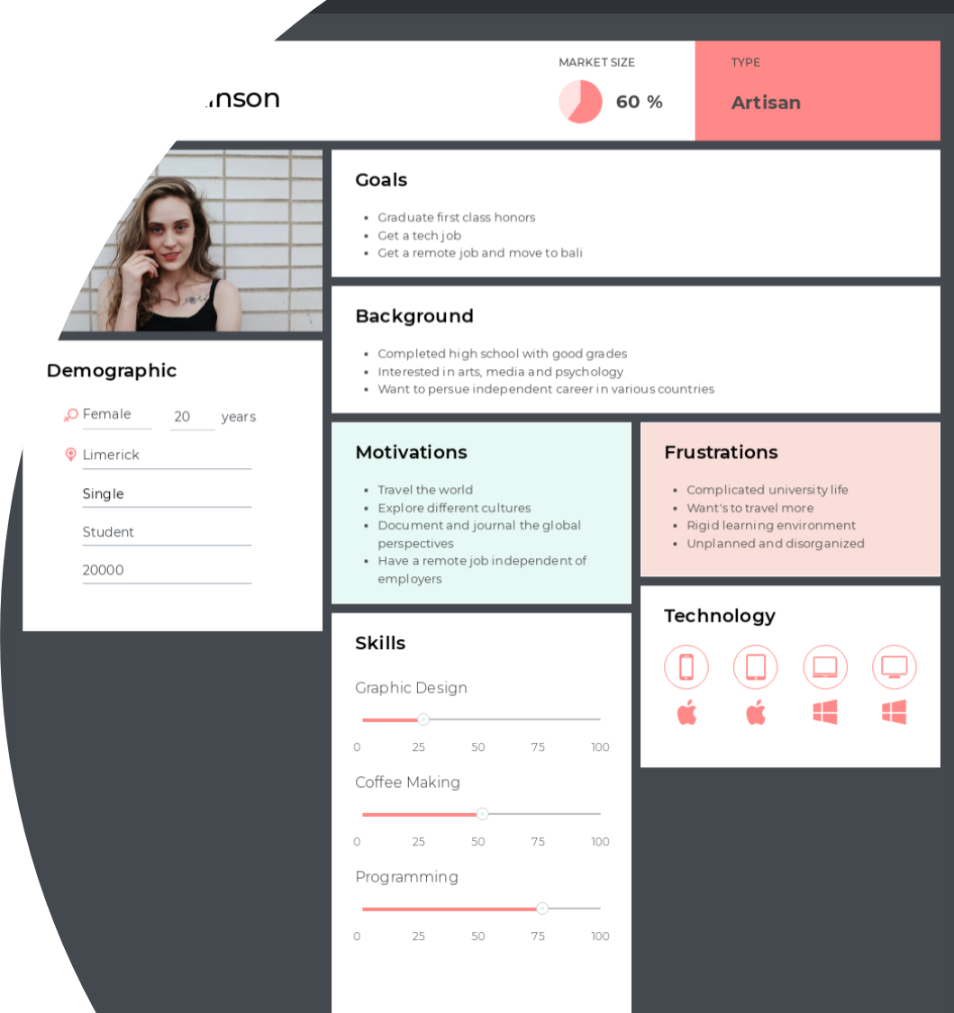
Persona

Slide 8
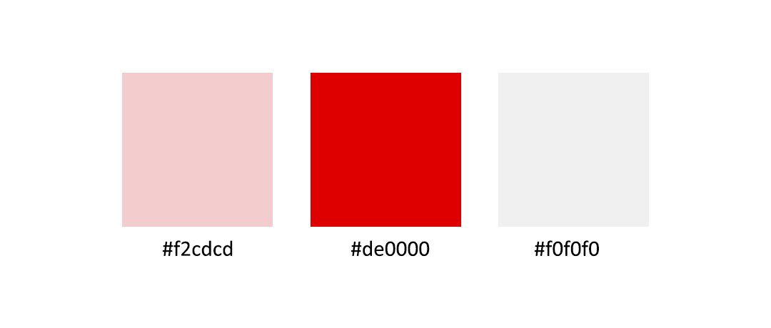
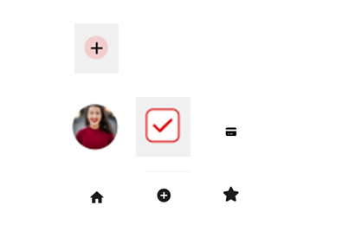


Elements of Design

Slide 9
Technologies
For App Android Studio – IDE Flutter – Framework Android's Location APIs and iOS's Core Location framework Firebase Authentication OR OAuth MySQL For Android- Firebase Cloud Messaging| iOS- Apple's Push Notification Service (APNs) Node.js Adobe XD, Sketch, or Figma Espresso for Android and XCTest for iOS – Testing secure data transmission (HTTPS) Google Play Store for Android and the Apple App Store for iOS | For Website WordPress Elementor Contact7 Plugin Adobe XD, Sketch, or Figma CSS Photoshop

Slide 10
Progress
I have taken a great step towards creating an app that connects mentors to mentees. There are several technologies available that can help I achieve this goal. Some of the best mentoring software that can be used to connect mentors and mentees include Qooper, MentorcliQ, Together Software, and MentorEase. These software systems offer a range of features such as templates, automation, analytics, and robust matching and tracking features that can help facilitate effective mentorship.
In addition to researching the available technologies, it’s also important to talk to people who have experience in this field. This can help I gain valuable insights into the challenges and opportunities that come with creating such an app. I can talk to mentors, mentees, and other professionals who have experience in this area to get a better understanding of what works and what doesn’t.
When creating an app that connects mentors to mentees, it’s important to keep in mind the needs of both parties. The app should be user-friendly and easy to navigate, with features that cater to the specific needs of mentors and mentees. It should also be scalable and customizable to meet the unique requirements of different organizations.
In conclusion, creating an app that connects mentors to mentees requires careful planning and research. By leveraging the available technologies and talking to people with experience in this field, I can create an app that is effective, user-friendly, and scalable.

